Slide 1
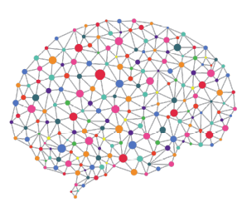
Cancer Classification using Deep Learning on Matched Biopsy Images and RNA-Seq
One Year Confirmation Seminar
Peter Donnelly
DD MMMM 2020
peter.donnelly@petermac.org

Slide 2
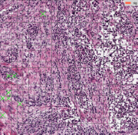
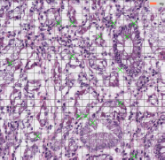
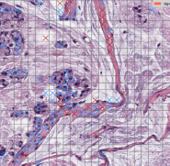
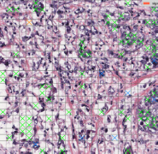
Clinical Motivation
Clinical Context
Cancers are still mainly detected and classified by inspection of biopsy tissue
but some are difficult or impossible to classify visually ...
… and two pathologists can classify the same sample differently
Classification determines treatment, so accurate classification matters
Computerised Classifiers
Active area of research
The best classify ‘straightforward’ cancer subtypes very well
They use either images or RNA-Seq
Why not use both ?
Biopsy images of the four main Stomach Adenocarcinoma
cancer sub-types (classified by my classifier)
Diffuse
Tubular
Diffuse
Mucinous
Signet Ring
Notes:
My thesis topic is “Cancer Classification using Deep Learning on Matched Biopsy Images and RNA-Seq”
In overview, the central idea is that a deep learning network which uses both digitised slide images and gene expression data in parallel should be able to improve our ability to classify cancers generally, and cancers that Pathologists currently find challenging to classify in particular
The images on the right are microscope slide scans of the four main types of Stomach Adenocarcinoma: Diffuse, Tubular, Mucinous and Signet Ring and perhaps surprisingly, despite the many breakthrough in genomics of the past 20 year or so cancers are still mainly detected and classified by a pathologist looking at stained biopsy tissue under a microscope, and that’s probably because it’s pretty effective, relatively cheap, and it has a 125 head start on genomics.
Cancer classification is the primary determinent of treatment, at least in the first instance, so timely and accurate classification is highly consequential
Using computers to automate classification is an active area of research; and the best computerised classifiers, can classify straightforward cancers very well – not necssarily subtypes; but these have yet to make much of clinical impact
They essentially all use either images or genomic data to perform classification, but it seems reasonable to assume that using both image and genomic data would be a more effective
strategy

Slide 3
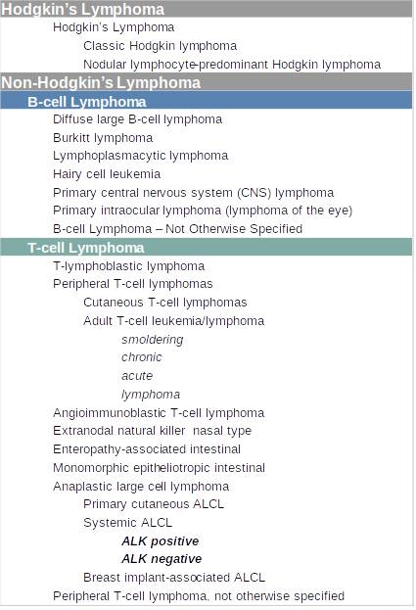

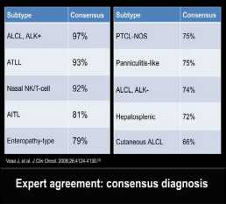
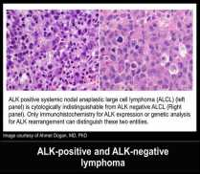
Lymphoma Classification
Pathologists find some T-Cell Lymphomas difficult to classify
  ALK+ and ALK- are almost indistinguishable
  Treatment for each differs
  + sub-type has the better prognosis
A Pathologists Guide to the Accurate Diagnosis of Peripheral T-Cell Lymphoma
Notes:
Some types of Lymphoma, Pancreatic cancer and Cancer of Unknown Primary are examples of cancers that pathologists find difficult to classify from histology images
T-Cell Lymphoma for example has a lot of sub-types, and they’re not all easy to differentiate
The examples I’ve highlighted here are ALK positive and ALK negative Anaplastic Large Cell Lymphoma.
These are morphologically almost indistinguishable
The study that these images came from found that inter-pathologist agreement in classifying ALK negative was only 74%.
And those two types of Lymphoma have markedly different survival rates and different treatment regimes, so again, accurate classification is consequential.

Slide 4
Hypothesis & Objectives
Hypothesis
A classifier trained on BOTH images AND RNA-Seq will
classify any cancers,
classify challenging cancers,
better than existing image or RNA-Seq specific classifiers
Has not been tested to date*
Key Assumption
Image & RNA-Seq don’t embody identical
classification relevant information
Objectives
Develop such a classifier
Show that it performs better than existing classifiers
RNA-Seq
Image
information relevant to classification is likely to overlap greatly but not completely
Notes:
More formally, my hypothesis is that a suitable classifier trained on BOTH images AND RNA-Seq
will be better at classifying classifying and subtyping cancers than any existing image or RNA-Seq specific classifier;
and further,
that such a classifier will be better at classifying and sub-typing challenging cancers than any existing image or RNA-Seq specific classifier
And that hypothesis is something that, to the best of my knowledge, has not been tested to date, at least not in published form
So my objective is to develop such a classifier, and show quantitatively that it performs better than existing classiers

Slide 5
Aims
Aim 1 is by far the largest task
Aim 1 – Build Classifier
Develop a classifier capable of testing the hypothesis
Success criteria: demonstration of a classifier able to classify arbitray TCGA (i) image (ii) RNA-seq data (iii) matched data
Metrics: Classification Accuracy, Precision, Recall
Aim 2 – Test the Hypothesis using TCGA Data
Success criterion: Classification performance better than any published paper classifying the same TCGA dataset
Metrics: Classification Accuracy, Precision, Recall, AUC
Aim 3 – Test the Hypothesis using PMCC Data
Success criterion: Classification performance equal to an experienced human Pathologist for the same subtypes, as documented in appropriate published paper(s) selected or validated by PMCC Oncologist
Metrics: determined by the metrics used in the selected paper(s)
Progress
90%
10
%
5
%
Notes:
Moving to Aims, my first aim is to develop a classifier capable of testing the hypothesis; and demonstrate that it can successfully classify arbitrary but straightforward cancers
Aim 1 is by far the largest activity in my thesis, and it’s currently about 90% complete
The second aim is test the hypothesis on publicly available data. The NIH TCGA repository is by far the best repository of matched image and rna-seq data, so I that’s the one I’m usinging it
The third aim is to validate the hypothesis on a challenging dataset, and for this I’ll be using 200 PMCC matched image + gene expression T Cell Lymphoma samples
Aim 1 is on the critical path for Aim 2 and Aim 3, since I can’t start these until I finish Aim 1. However I have been testing and validating the classifier all the way through development, and I’ve already run the evolving classifier thousands of times on many hundreds of samples (STAD, SARC, BCL, TCL)
There’s a project plan corresponding to these aims at the end of the presentation, and on page 6 of the Report

Slide 6
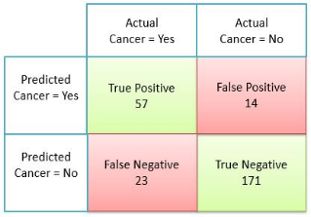
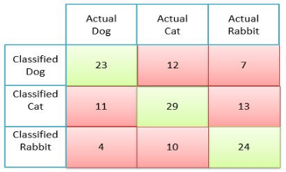
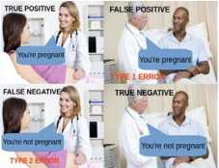
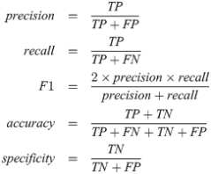
What Makes a Good Classifier?
Classifier effectiveness is evaluated with a Confusion Matrix
The confusion matrix below is for two classes ...
… but multi-class confusion matrices works identically
n=265
n=133
Demystifying Confusion Matrix and Performance Metrics in Machine Learning
All key statistics come directly from the Confusion Matrix
Understanding the Confusion Matrix
Notes:
Clearly, testing the hypothesis requires using some suitable metrics. Fortunately, such metrics are well defined and universally agreed; and they centre on an object called a “Confusion Matrix”, so if I use this approach I’ll be able to very easily compare the performance of my classifer to others that are out there
The Confusion Matrix at top left is the type that’s used for binary classification tasks; for example cancer detection: “Yes it’s cancer” or “No it’s not cancer”.
The column headings are “Actual” or ‘ground truth’ and the row headings are the ‘Prediction’. Here, the classifier can classify the 265 examples in one of four possible ways: the green cells are the good ones: “cancers that were classified as cancers” and “non-cancers that were classified as normal”. The red cells are the the bad ones: “non-cancers that were classified as cancers” and “cancers that were classified as normal”
For multiple classes, we a the Confusion Martrix like the one at top right, which is an obvious extension of the binary version: the 123 photos of Dogs, Cats or Rabbits, can either be classified correctly – the 3 green cells – or misclassified in one of the six possible ways shown in the red cell.
The Confusuin Matrix is always used in conjuction with one or more of the statistics at bottom right; which in turn fall straight out of the Confusion Matrix. The most important ones for me are Precision, which indicates how good the model is at not generating false positives; Recall, which indicates how good the model is at not generating false negatives, and F1 score, which is the geometric mean of Precision and Recall, and puts the overall performance into a single number.

Slide 7
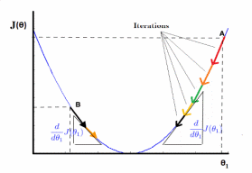

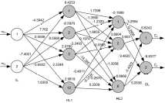

Supervised Learning
Phase 1: Training (80% of examples)
Inputs
Process
Output
labelled examples
iteratively improve model weights
optimized model
Muc
Tub
Tub
Diff
Muc
Muc
Diff
Tub
Muc
Diff
Diff
Sig
Tub
Phase 2: Testing (20% of examples)
Inputs
Process
Outputs
unlabelled examples
push inputs through optimized model
labels
Diff

Muc

Muc


Slide 8


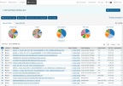
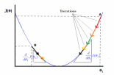


My Experiment System / Classifier
Fetch Raw Data
Pre-process Raw Data
Realize Optimum Model
Classify
Analyse Results
break
images
into tiles
remove background & degenerate
tiles
normalize
Colors
Image Branch
tiles
patches
Numerical normalization
TCGA
Extract
RNA-Seq
data
Reduce dimens-
ionality
resolve
gene
names
RNA Branch
RNA-Seq
Notes:
Concretely, this is a schematic of the Classification System that I’ve developed over the past 12 months and am using for my experiments. As mentioned, it’s currently about 90% complete.
It is able to classify from images, or from rna-seq, but not yet from both images and rna-seq together
So I can use it to establish a baseline for testing the hypothesis, but I can’t yet use it to test the hypothesis.
I’m not sure if it comes through from this image, but I’ve built it as an end to end experiment system which automates the experiment process as much as possible. For two main reasons: one is that it turns that acquiring and pre-processing the data requires an enormous amount of effort, and it’s just not something that you’d want to do manually, for reasons of both time and quality control; the second reason is that neural networks require a significant amount of tuning to achieve good performance: and having a system where experiments are defined parametrically allows me to run experiments in batch fashion, where I can vary one of more parameters and very easily observe the effect on the outcome.
So for example I can set a job up to run overnight which has five different learning rates and three different neural network types and look at the learning cruves the next day to see the effect of the different parameters in the outcomes.

Slide 9
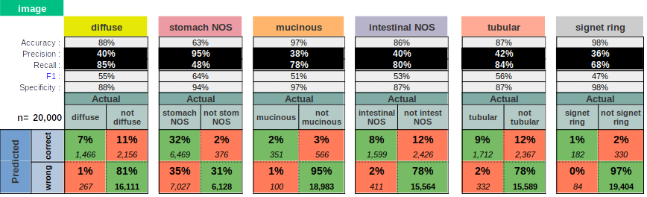
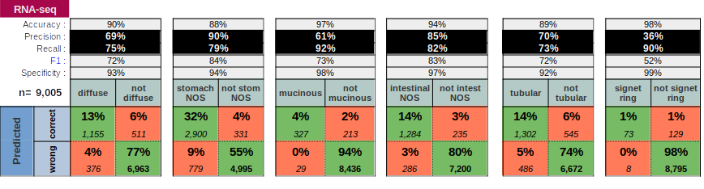
Preliminary Results
Classification of 20% held-out examples for Stomach Cancer: 4 runs (Images); 101 runs RNA-Seq
Notes:
Moving now to the quantitative results, and again, these are image-only and rna-seq only at this stage, so they’re not testing the hypothesis
These Confusion Matrices show the performance of the classifier in classifying held-out samples for the six stomach cancer subtypes: aggregated over 4 runs for the images and 101 runs for the rna-seq, and in both cases, 80% of the samples are used for training and 20% held out for testing.
You’ll note that there are four positively defined subtypes: diffuse, tubular, mucinous and signet ring; and two ‘bucket’ categories: Stomach Not Otherwise Specified and Intestinal Not Otherwise Specified and I’ll say a little about that on the next slide
So what are we seeing here? Overall the headline Accuracy figures looks prety good, but they’re not not backed up by good Precision and Recall values
These results are pretty typical of what others achieve; and they form the baseline for my system to improve on with matched samples, in accordance with the thesis
For the images, I took 2,500 tiles from each of 229 samples, so that giving a training set of 458,000 and a test set of 114,500 tiles. Then 5000 held out tiles were selected at rnadom for processing by the opimised model for each of the four runs, and the the top table summarises the classifier’s performance over these 20,000 tile classifications.
For rnathe -seq, 80% of the 479 rna-seq samples, which is 383 samples, were used for training, and the remaining 20% or 96 were held out for testing in each of the 101 runs. The bottom table summarises the classifiers’ performance on the 96x101=9696 classifications.

Slide 10
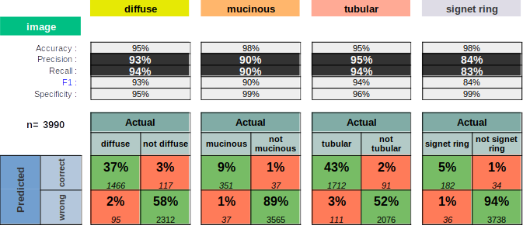
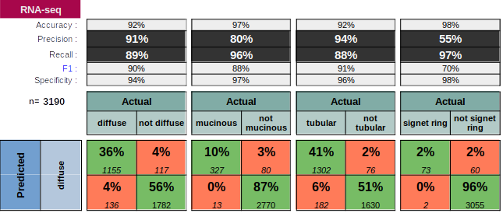
Just the Four Positively Defined Subtypes
(i.e. excluding the two NOS subtypes)
Conclusion: The NOS subtypes are significant confusers
Notes:
As an aside
If we remove the two Not Otherwise Specified from consideration, the classification performance dramatically improves, which tells us that the classifier had no problem at all in differentiating the four positively defined subtypes: so it’s the Not Otherwise Specified subtypes that are causing most of the confusion; which isn’t that surprising, since the NOS subtypes presumably include all sorts of mutated cells, including cells that look a bit like or a lot like the positively defined subtypes.
This isn’t a clinically useful observation, however, since we care greatly about positively defined subtypes.that are wrongly classified as NOS, and about NOS subtypes that are wrongly classified as positively defined subtypes.

Slide 11
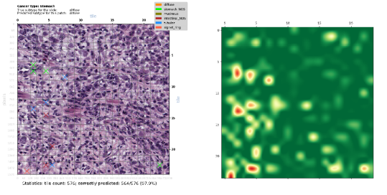
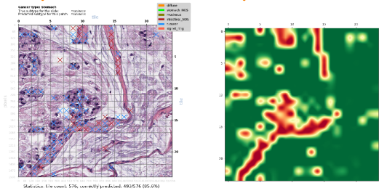
Classification of Contiguous Patches: Many Tiles From Same Sample
Randomly selected 24x24 tile patches (576 tiles)
Cross (‘X’) colour shows misclassified tile subtype; heatmaps show tile-level prediction confidence p(0,1)
Highly Confident and
Correct Prediction of Diffuse Subtype
(564/576=97.9% of tiles)
Moderately Confident and Correct Prediction of Mucinous Subtype
(485/576=85.6% of tiles)
Notes:
Here are some results from the preliminery experiments I’ve conducted, scored in that manner.
This and the next two slides are visual; after that I’ll present summary quantitative results from the same experimental run.
The patch size here is 576 tiles, and the way to read the images on the left is like this: if a square has a coloured X in it, the tile has been misclassified, and the colour indicates the subtype it was misclassified to. If a tile doesn’t have an x in it, it was correctly classified. The heatmaps on the right show the confidence of the classifier’s top prediction on a green-red spectrum, where dark green means highly confident and dark green means highly unconfident
The top result shows a highly confident prediction of Diffuse Subtype – highly confident because 98% of the tiles were classified correctly, and the heatmap further indicates that the tile level predictions were mostly quite high for the correct subtype and low for other subtypes
The bottom results shows a moderately confident prediction of Mucinous Subtype. Here, only 86% of the tiles were classified correctly – the tiles with red and blue x’s are wrongly classified. And further the heatamp shows some areas of very low confidence for some regions.

Slide 12
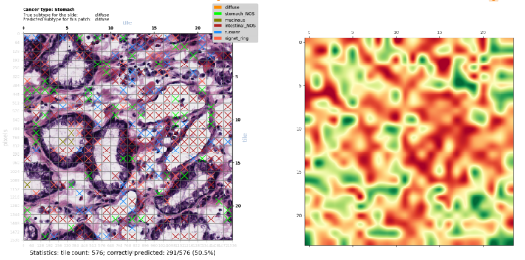
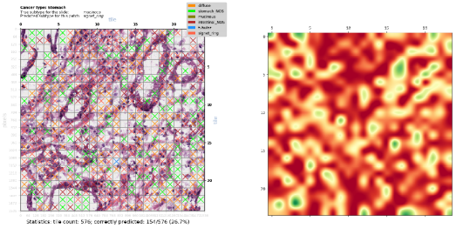
Classification of Contiguous Patches: Many Tiles From Same Sample
Randomly selected 24x24 tile patches (576 tiles)
Cross (‘X’) colour shows misclassified tile subtype; heatmaps show tile-level prediction confidence p(0,1)
Unconfident
but Correct Prediction of Diffuse Subtype
(291/576=50.5% of tiles)
Badly Wrong Prediction of Diffuse Subtype
as Signet Ring Subtype
(154/576=26.7% of tiles)
This is the worst misclassification of all 229 images
Notes:
The case at the top here shows a very unconfident but nonetheless correct prediction of Diffuse Subtype. In this case a little over one half of the tiles are correctly classified, and the heatmap shows that the predictions are largely unconfident. So we would not like to rely on this prediction
And finally, the case at bottom shows a badly wrong pediction of Diffuse Subtype as Signet Ring subtype. Yoiu can see from the clored Xs that there was a lot of confusion with Diffuse Subtype and the two ‘Not Otherwise Specified’ categories. Why so badly wrong? It may be because there were relatively few examples of the Signet Ring subtype for the network to learn from, or it may be because Signet Ring subtype is harder to discern visually, which it probably is; or more likely both of these.

Slide 13
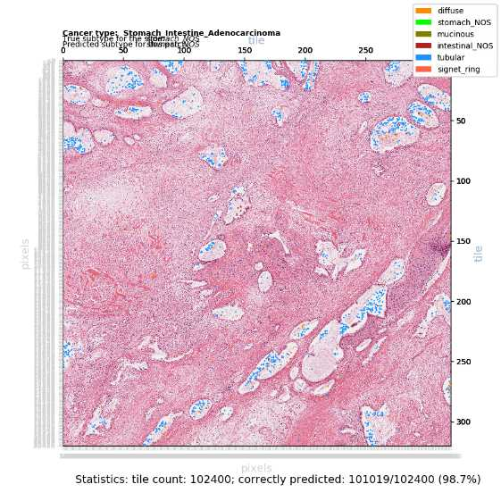
Classification of Larger Patch:
Patch of 320 x 320 = 102,400 tiles (420 mega-pixels)
The pink areas are correctly classified
The blue and orange areas are misclassified
Notes:
The four examples I just showed use quite small patch sizes – I did this so you could easily see the X’s. But the patch size can be arbitrarily large, subject only to available computing memory.
So here we have a much larger 420 megapixel patch comprising 102,400 tiles, and it’s a correct classification of a Stomach NOS sample. The tiny blue and orange areas if you can see those, are incorrectly classified, but all of the rest - the pink and white areas are correcrty classified.

Slide 14
The Next 18 Months
Complete the Classifier
Support for match samples (multimode)
Support for multiple magnification levels
Perform the Experiments that will test the Hypothesis
Using TCGA data
Using PMCC Lymphoma data
Write the Thesis
Notes:
So, closing,
This is what I need to do over the remaining 18 months of my thesis:
I’m budgeting 2 months to complete the classifier, and this includes running the first experiments to test the hypothesis
Performing the experiments to test the hypothesis won’t actually take very long after that, subject of course to my actually having the samples. The TCGA samples are all already available, and I’d like to have the Lymphoma samples on or before March 2020. At the mment I have a commitment that I’ll have these, but not yet a delivery date.
I’m assuming I’ll spend most of the last year finessing excperinments and writing the thesis, but I’ve also mentioned two stretch objectives tha

Slide 15
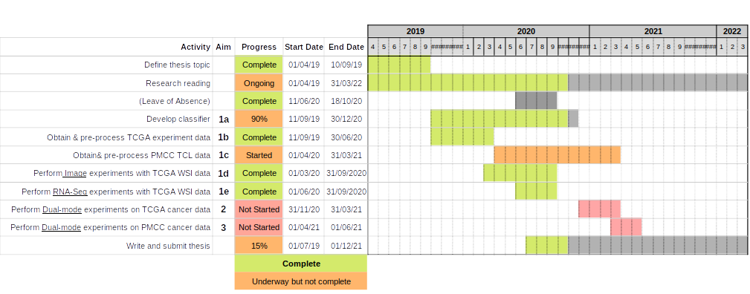
Overall Timeline
Notes:
And finally this is the overall timeline, which can also be foun in the report

Slide 16
Spare

Slide 17
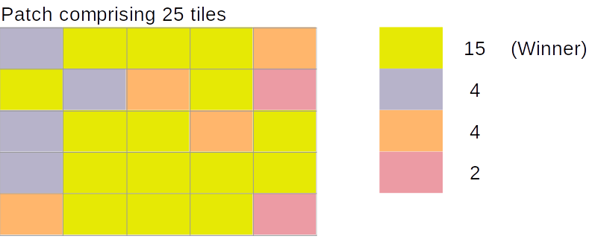
Scoring
Tile Level Scoring
Class with the highest probability wins
Patch Level Scoring
Add up the number of tiles in each class as per Tile Level Scoring
Class with the most number of tiles wins
Notes:
I want to move to some preliminary results now but, first I need to explain the scoring method.
For rna-seq it’s very straightforward: the class given the highest probability by the classifier is the winner
For images, it’s a little more complicated. The neural network can’t look at the entire image all at once, the images are 1 and 5GB each, so it’s just not practical to do this even with the very powerful computers that we now have available
Rather, what we do is break the image into tiles, and feed these tiles into the classifier. I’m typically using 2000 – 5000 64x64 pixel tiles per image, selected at random from non-degenerate areas of the image
The image classifer learns from and classifies at the tile level, producing a probability that the tile belongs to each of the six subtypes. So we then extract a contiguous 2D patch from each sample (I’ll show you these momentarily) and come up with a single prediction for the patch acting as proxy for the slide by adding up the number of tiles in the patch that correspond to each sub-type. This is a relatively simple scoring process that I’ll refine for the experiments proper, but it’s good enough for the present purposes.

Slide 18
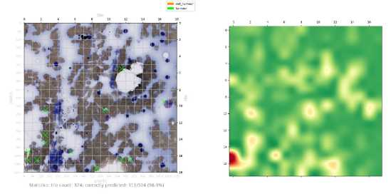
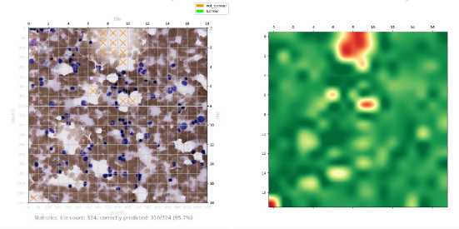
TCL Images:
Trained on only 9 images – ignore classifications

Slide 19
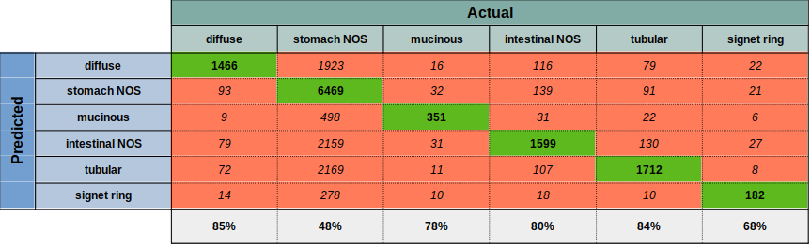
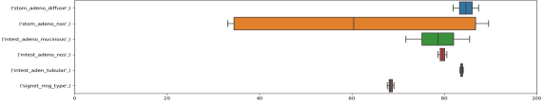
Preliminary Results: Subtyping 229 TCGA STAD Whole Slide Image Samples
Predicted vs True subtype for held out samples. 4 runs
Classification of 229 TCGA STAD H&E stained tissue samples (Six subtypes including two NOS subtypes)
Each sample is represented by 2500 randomly selected 64x64 pixel tiles. Background and degenerate tiles are excluded
Total of 229 x 2,500 = 572,500 tiles used for training and validation testing: 80% (n=458,000) training set + 20% (n=114,500) validation
5000 randomly chosen held-out tiles are tested after each run, yielding 20,000 total predictions of held-out tiles
Neural Network details: VGG11 = 11 layer convolutional (relu + softmax activation) network; ADAM optimiser. Reasonably well tuned
20 epochs per run. Each of the 4 runs produces a slightly different optimised classifier. See box plot
Observations
Classification accuracy ranges from 48-85% (all subtypes). Misclassification to NOS accounts for most misclassifications (35%)
Classification accuracy rises to 95-98% when the two NOS categories are removed (slide after next)
Much less variance between runs than for RNA-Seq, except for stomach NOS which has very high variance
No obvious explanation for the high variance between runs seen with stomach NOS
Classification of 5000 held-out tiles for each run (=20,000 predictions total) - All Six Subtypes
Replicability: percent correct for each category over the 4 runs

Slide 20

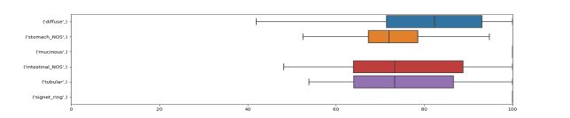
Preliminary Results: Subtyping 479 TCGA STAD RNA-Seq Samples
Predicted vs True subtype for held out samples. 101 runs.
Classification of 479 TCGA STAD RNA-seq samples (Six subtypes)
Each example is a vector comprising 60,483 mRNA + lnRNA Upper Quartile FPKM values (Frequency per kilobase per million reads mapped)
479 RNA-Seq examples per run for training & validation testing: 80% (n=383) training + 20% (n=96) validation testing
All held-out samples are tested after each run yielding 96 x 101 = 9,696 total predictions of held out samples over the 101 runs
Neural Network details: 3 layer fully connected network (relu + softmax activation); ADAM optimiser. Reasonably well tuned
200 epochs per run. Each of the 101 runs produces a slightly different optimised classifier. See box plot.
Observations
Absolute (rather than differential) RNA-seq expression data contains sufficient information to classify STAD subtypes quite well
Classification accuracy ranges from 70-90%% across the six subtypes
Misclassification to NOS accounts for most misclassifications (48%). This makes sense, as NOS is a heterogeneuous catch-all subtype.
Classification accuracy rises to 94-98%% when the two NOS categories are removed (next slide)
Classification of held-out test sets for each run (=9,696 predictions total) - All Six Subtypes
Replicability: percent correct for each category over the 101 runs

Slide 21
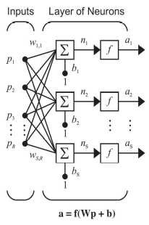

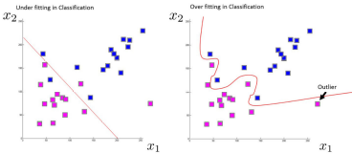
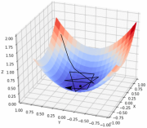
Neural Networks for Cancer Classification: Learning from Data
While there are many good classification algorithms (SVN, Random Forest ...), supervised neural networks are particularly effective classifiers
A Deep Learning network is just a neural network with many layers of neurons
With any kind of supervised neural network:
experts (e.g. pathologists) supply correctly labelled examples;
the network iteratively learns from this ‘Training Set’, resulting in a model which, hopefully;
generalizes well and can classify new, unseen examples (Test Set)
In more detail:
Start off with random weights (w_{i,i})
process a batch of inputs (p) from the Training Set
quantify batch loss: true ‘minus’ predicted classes
apply chain rule to loss, then update weights
try again with new weights
do over and over
Periodically validate with examples randomly drawn from the Test Set
signet_ring_type
intest_adeno_nos
stom_adeno_diffuse
Vito Gentile on Stack Overflow forum
With a pencil: 1 dimensional curve classifying 2 classes
With an NN: perhaps 100,000 dimensional hyperplane classifying (say) 6 cancer subtypes
When training a well parameterized model, most iterations will result in the loss (black line) reducing; stepping towards the minimum of the red/blue sheet corresponding to maximum classification accuracy
Microsoft - Tokyo DMM Machine Learning Tech Talk
Introduction to Optimization in Deep Learning: Gradient Descent

Slide 22
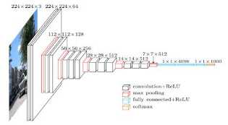
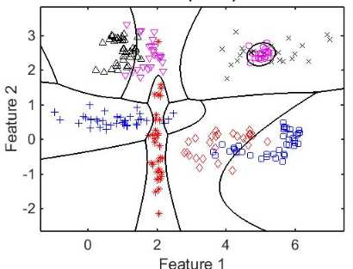

Automatic Classification: Learning from Data
‘VGG16’ – A Convolutional Neural Network
Many good classification algorithms (SVN, Random Forest …)
Supervised neural networks are particularly good
Deep Learning network = neural network with many layers
The classifier below is using 2 features to classify 8 classes
For the TCGA Stomach Cancer dataset (8 classes) I use:
  Images: 3x64x64=12,288 features
  RNA-Seq: 60,482 features
Understand the architecture of CNN
multi-class classification
Notes:
There are a lot of different kinds of classification algorithms, many quite good.
I’ve chosen to use a Neural Network based classifier, because they’re currently ‘best-in-class’ for classification, but whatever the type of classifier, they’re all trying to do the same thing, and that is, given a number of samples, each characterised by a set of features – divide the samples into a set of classes that captures the essential aspect of the class definitions.
In the made up example shown here, the classifer is using two features to classify six classes, but for example, in the case of the stomach cancer dataset I’m working with, the classifier is using many thousands of features – pixels intensities in the case of images and numerical values in the case of rna-seq, to classify 6 cancer subtypes
More specifically, I’m using neural networks in a Supervised Learning mode, where we train the network using a set of images for which the true cancer sub-type is known, and then challenge it to produce the correct classification for image samples that it’s never seen before.
And in fact the type of neural network that I’m for image classification is the VGG classifier, out of Oxford University, that’s shown here.

